Slide 1
Blessed are the merciful
Notes:
In an election cycle, like we are in now, we hear lots about our founding principles. One of these principles is embodied in our Pledge of Allegiance, which closes with the words, One Nation, Under God, with Liberty and Justice for All. We desire justice. However, I must say that there is one arena in which I do not desire justice. And that is when it comes to my eternal destiny. Listen to these words by Jeremy Taylor that introduce our next beatitude in the Upside Down Living Series.

Slide 2
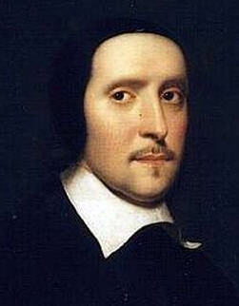
Jeremy Taylor
“Mercy is like the rainbow, which God hath set in the clouds; it never shines after it is night -- If we refuse mercy here, we shall have justice in eternity.”
Notes:
“Mercy is like the rainbow, which God hath set in the clouds; it never shines after it is night -- If we refuse mercy here, we shall have justice in eternity.”
I don’t want justice in eternity. True justice is that I would pay the penalty for my own sins. But that is a debt that I cannot satisfy. And that means that I need to be really motivated to show mercy. Listen to Jesus’ own words.

Slide 3
Matthew 5:7
Blessed are the merciful, for they shall receive mercy.
Notes:
Matthew 5:7
Blessed are the merciful, for they shall receive mercy.
Jesus and the other inspired authors of scripture have more to say on this important topic. Let us explore together the teaching in God's Word on this practical issue.

Slide 4
First Point
The mercy of God is undeserved.
Notes:
First Point
The mercy of God is undeserved.
There are two words that often appear together in scripture… mercy and grace. We find them together in Ephesians 2, verses 4 through 5:

Slide 5
Ephesians 2
⁴ But God, being rich in mercy, because of the great love with which he loved us, ⁵ even when we were dead in our trespasses, made us alive together with Christ—by grace you have been saved—
Notes:
Ephesians 2
⁴ But God, being rich in mercy, because of the great love with which he loved us, ⁵ even when we were dead in our trespasses, made us alive together with Christ—by grace you have been saved—
These two words, mercy and grace, are key to our salvation. But, they are not synonymous. But what is the difference between them In order to answer this, we need to look more closely at the origin of these words in the biblical text.

Slide 6
ἐλεήμων/ eleēmōn
Strong’s Concordance:
Merciful, including feelings of pity, with a focus of showing compassion to those in serious need.
Notes:
ἐλεήμων/ eleēmōn
Definition:
Merciful, including feelings of pity, with a focus of showing compassion to those in serious need.
So, mercy has to do with God’s response to our need and our corresponding response to the needs of others.

Slide 7
χάρις/ charis
Grace; God’s favor or benefit extended to us, although unearned.
Notes:
χάρις/ charis
Definition:
God’s favor or benefit extended to us, although unearned.
It’s easy to see how the lines between these two words become fuzzy. God is merciful and gracious to us. Both proceed from God and are his gifts to us. I came across a quote that helped me see the nuance of difference here.

Slide 8
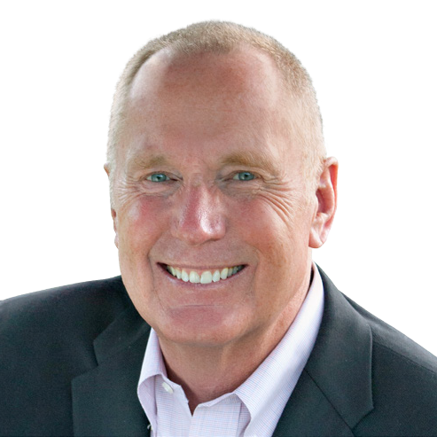
Mercy and Grace
“The difference between mercy and grace? Mercy gave the prodigal son a second chance. Grace gave him a feast.”
Max Lucado
Notes:
Mercy and Grace: Max Lucado
“The difference between mercy and grace? Mercy gave the prodigal son a second chance. Grace gave him a feast.”
I found that this quote really helped me to see how these two aspects of God’s kindness to us work together. And one of the things that it really drives home is how badly we all need a second chance. There are so many ways that we blow it, especially when it comes to being merciful. But I would have to say that the arena in which we blow it most consistently is not in church. It’s at home. Home is the place where we feel safest. But, it’s also the place where we allow our worst behaviors to manifest themselves. Yet, it is at home where mercy is most needful. I came across this statement by Rick Warren that really impacted me.

Slide 9
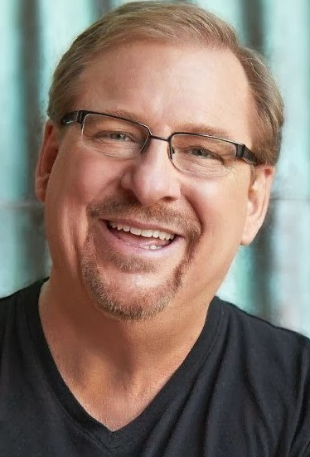
Showing Mercy
“The number one place you need to learn to show mercy is at home because you see each other’s faults far more than anyone else us does…
Rick Warren
Notes:
“The number one place you need to learn to show mercy is at home because you see each other’s faults far more than anyone else us does…

Slide 10
Showing Mercy
“… and you’re up close and personal with those faults and you’ve got to live with them for the rest of your life, so show mercy.”
Rick Warren
Notes:
“… and you’re up close and personal with those faults and you’ve got to live with them for the rest of your life, so show mercy.”

Slide 11
Second Point
The mercy of God is conditional.
Notes:
Second Point
The mercy of God is conditional.
We usually emphasize the unconditional aspects of God's relationship with us. This is especially true of His love for us. It is the apostle Paul who wrote:

Slide 12
Romans 5:8
⁸ but God shows his love for us in that while we were still sinners, Christ died for us.
Notes:
⁸ but God shows his love for us in that while we were still sinners, Christ died for us.
However, there are times when God speaks to His children about conditions, cause and effect relationships. One of these areas is mercy.

Slide 13
Matthew 5:7
Blessed are the merciful, for they shall receive mercy.
Notes:
Blessed are the merciful, for they shall receive mercy.
This is a positive statement which suggests by its conditionality a negative converse, Cursed are the merciless for they shall not obtain mercy. Jesus taught this more severe aspect of this teaching in a parable, the Parable of the Unmerciful Servant.
Jesus and the other inspired authors of scripture have more to say on this important topic. Let us explore together the teaching in God's Word on this practical issue.

Slide 14
Notes:
One of Jesus most dramatic parables is the Parable of the Unmerciful Servant. The story begins with a man in a desperate position. He owes an obscene amount of money. It’s more than he will ever be able to pay back. If fact, more time would do nothing but allow the debt to grow further. So, the master orders the man and his family thrown into a debtors prison. But he pleads for mercy and the master is moved by pity and forgives his entire debt.
Jesus is painting a picture of the enormity of our debt before God. It is a debt we can never pay. No amount of time will improve things. We desperately need debt forgiveness.
But you remember what happens next. This servant, forgiven a debt that by today’s standards would be in the millions of dollars, finds some poor fellow who owed him a little over 3 months of salary. It’s the kind of debt you could fall into really easily if you were injured on the job, or your house was damaged badly in a storm. By comparison, it’s a tiny debt. But there is no forgiveness in the heart of this forgiven servant. He chokes the man and threw him and his family in jail. But there is something he forgot. He failed to take into account the reaction of the other servants. They go to their master who had forgiven the fortune this unmerciful man owed and they report what he has done. The reaction is strong and immediate. Look at Matthew 18 starting in verse 32:

Slide 15
Matthew 18
³² Then his master summoned him and said to him, ‘You wicked servant! I forgave you all that debt because you pleaded with me.
Notes:
³² Then his master summoned him and said to him, ‘You wicked servant! I forgave you all that debt because you pleaded with me.

Slide 16
Matthew 18
³³ And should not you have had mercy on your fellow servant, as I had mercy on you?’
Notes:
³³ And should not you have had mercy on your fellow servant, as I had mercy on you?’

Slide 17
Matthew 18
³⁴ And in anger his master delivered him to the jailers, until he should pay all his debt.
Notes:
³⁴ And in anger his master delivered him to the jailers, until he should pay all his debt.

Slide 18
Matthew 18
³⁵ So also my heavenly Father will do to every one of you, if you do not forgive your brother from your heart.”
Notes:
³⁵ So also my heavenly Father will do to every one of you, if you do not forgive your brother from your heart.”
God's mercy should elicit a response of gratitude on our parts, a gratitude which expresses itself in kind and merciful treatment of others. Where do we see this kind of sick mercilessness today? One place that I see this is in the heart of judgmental people. Like the unmerciful servant, the judgmentalist is someone who forgets that once, not so terribly long ago, he too was a debtor. Like the unmerciful servant, the judgmental Pharisee sees little or no relationship between the way God has treated him and the way he treats others. He ignores the golden rule and operates under the commando rule, "Do unto others, then run.“
God's justice will not allow abuses of His mercy.
The unmerciful servant thought that he could have the best of both worlds. Not only could he be debt free, but in shaking down his fellow slave and recouping his personal losses, he could actually get a head start to life on easy street. However, there are two things that the unmerciful servant did not count on.
*He failed to consider the conscience of the slave community, a conscience which was stretched to the limit by this abuser.
*He failed to consider the conscience of the master, a conscience which was so deeply offended that he responded by re-instating the forgiven debt.
God's mercy in our lives is not a suspension of His justice. The justice of God leaves room for mercy. Furthermore, the justice of God demands that the recipients of mercy would themselves become the instruments of God's mercy to others.

Slide 19
Third Point
Opportunities to Show Mercy.
Notes:
Third Point
Opportunities to Show Mercy.

Slide 20
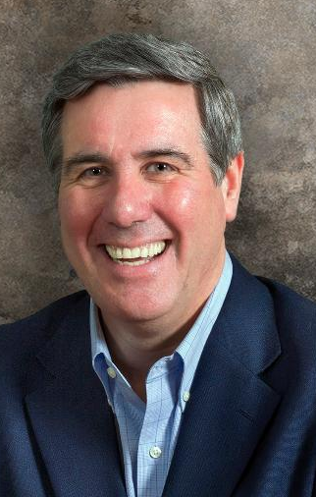
Colin Smith
1. Material Needs
If anyone has the world’s goods and sees his brother in need, yet closes his heart against him, how does God’s love abide in him? 1 Jn. 3:17
Notes:
1. Material Needs
Colin Smith

Slide 21
Colin Smith
2. Spiritual Struggles
Have mercy on those who doubt.
Jude 22
Notes:
2. Spiritual Struggles
Have mercy on those who doubt.
Jude 22
Colin Smith

Slide 22
Colin Smith
3. Embarrassing Failures
Love covers a multitude of sins.
1 Peter 4:8
Notes:
3. Embarrassing Failures
Love covers a multitude of sins.
1 Peter 4:8
Colin Smith

Slide 23
Colin Smith
4. Slanderous Gossip
Love bears all things, believes all things, hopes all things, endures all things.
1 Corinthians 13:7
Notes:
4. Slanderous Gossip
Love bears all things, believes all things, hopes all things, endures all things.
1 Corinthians 13:7

Slide 24
Colin Smith
“There is a harshness in our culture (and too often it is creeping into the church) that is quick to believe the worst about a person, and slow to think the best.”
Notes:
There is a harshness in our culture (and too often it is creeping into the church) that is quick to believe the worst about a person, and slow to think the best.”
Colin Smith

Slide 25
Colin Smith
5. Unreasonable Expectations
God knows our frame; he remembers that we are dust.
Psalm 103:14
Notes:
5. Unreasonable Expectations
God knows our frame; he remembers that we are dust.
Psalm 103:14
Colin Smith

Slide 26
Colin Smith
6. Personal Injuries
Be kind to one another, tenderhearted, forgiving one another, as God in Christ forgave you.
Ephesians 4:32
Notes:
6. Personal Injuries
Be kind to one another, tenderhearted, forgiving one another, as God in Christ forgave you.
Ephesians 4:32
Colin Smith

Slide 27
Colin Smith
“If someone has hurt you… at some point in your life God may very well put you in a position where you have the opportunity to get your own back”
Notes:
If someone has hurt you… at some point in your life God may very well put you in a position where you have the opportunity to get your own back”
Colin Smith

Slide 28
Colin Smith
“God may at some point put them under your power. And when that happens, what you do will be the most revealing thing about you.”
Notes:
God may at some point put them under your power. And when that happens, what you do will be the most revealing thing about you.”
Colin Smith

Slide 29
Colin Smith
7. Lost Souls
Save others by snatching them out of the fire; to others show mercy with fear.
Jude 23
Notes:
7. Lost Souls
Save others by snatching them out of the fire; to others show mercy with fear.
Jude 23
Colin Smith

Slide 30
Colin Smith
“If you have mercy within your heart, you are going to talk to Christ a great deal about lost people and you’re going to talk to lost people a great deal about Jesus Christ.”
Notes:
If you have mercy within your heart, you are going to talk to Christ a great deal about lost people and you’re going to talk to lost people a great deal about Jesus Christ.”
Colin Smith

