Slide 3
"There will be no major solution to the suffering of mankind until we reach some understanding of who we are, what the purpose of Creation was, and what happens after death. Until these questions are resolved, we are caught."
Woody Allen
Notes:
"There will be no major solution to the suffering of mankind until we reach some understanding of who we are, what the purpose of Creation was, and what happens after death. Until these questions are resolved, we are caught."
Woody Allen

Slide 4
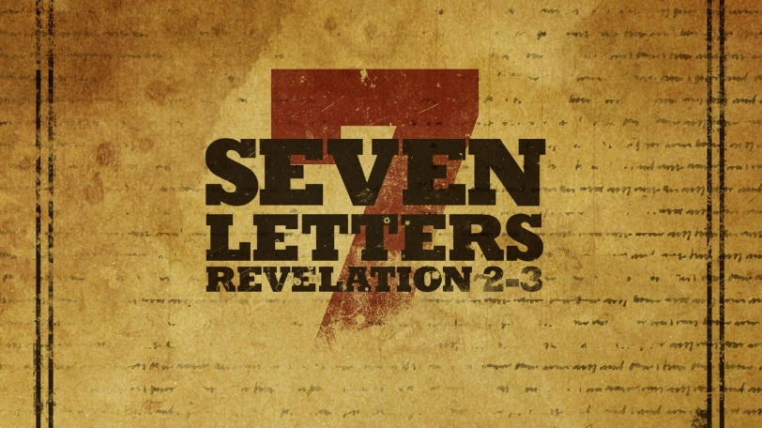
The Church of Smyrna
The redemptive value of suffering.
Notes:
The Church of Smyrna
The redemptive value of suffering.

Slide 5
First Point
God is aware of our suffering.
Notes:
First Point
God is aware of our suffering.

Slide 6
Revelation 2
⁸ “And to the angel of the church in Smyrna write: ‘The words of the first and the last, who died and came to life.
Notes:
Revelation 2
⁸ “And to the angel of the church in Smyrna write: ‘The words of the first and the last, who died and came to life.

Slide 7
Revelation 2
⁹ “‘I know your tribulation and your poverty (but you are rich) and the slander of those who say that they are Jews and are not, but are a synagogue of Satan.
Notes:
⁹ “‘I know your tribulation and your poverty (but you are rich) and the slander of those who say that they are Jews and are not, but are a synagogue of Satan.

Slide 8
God knows of human suffering…
God knows of human suffering by personal experience with suffering.
God knows of human suffering through a personal relationship with His suffering children.
Notes:
God knows of human suffering…
God knows of human suffering by personal experience with suffering.
God knows of human suffering through a personal relationship with His suffering children.

Slide 9
Smyrna was a city of great wealth
Notes:
Smyrna was a city of great wealth
Excellent harbor on the east shore of the Aegean Sea.
b. Secure: naturally defensible.
c. Like Ephesus, an important trade route passed through Smyrna.

Slide 10
Smyrna was a city of great beauty
Notes:
Smyrna was a city of great beauty
It was a city of considerable beauty.
a. Original city destroyed by Alyattes, King of Lydia.
b. Re-built over 300 years after its destruction by Lysimachus and Antigonus as a model city in 290 BC.
Illustration: "The best thing that ever happened to Chicago was the Chicago fire."
-- Population: 200,000
-- largest public theater in Asia
-- two large and impressive temples (Cybele and Zeus)
-- Acropolis on Mt. Pagus called "crown of Smyrna"
-- Coins: "First of Asia in beauty and size."

Slide 11
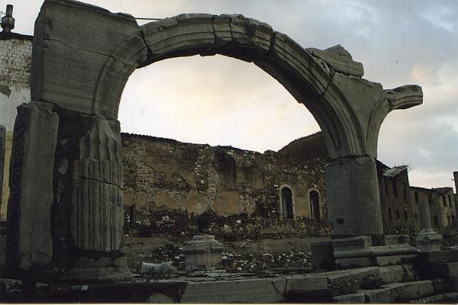
The Church in Smyrna
Notes:
However, this great city was a place of great suffering for the Church at Smyrna.

Slide 12
The Church in Smyrna was vigorously persecuted by the Gentiles.
Notes:
The Church in Smyrna was vigorously persecuted by the Gentiles.
1. The church was vigorously persecuted by the Gentiles.
a. Smyrna had forged a strong allegiance to Rome.
(Punic Wars: 265-146 BC: Rome vs. Carthage. Smyrna sided with Rome.)
b. 195 B.C: Smyrna was the first city in the ancient world to construct a Temple to the Roman gods.
c. 23 BC: Smyrna won permission over 10 other Asian cities to build a Temple to Emperor Tiberius.
The increasing persecution of the Christians by Rome was supported enthusiastically in Smyrna.

Slide 13
The Church in Smyrna was equally persecuted by the Jews.
Graphically illustrated in the 2nd century account of the martyrdom of Polycarp.
Jewish leaders functioned as informers to the Romans against the Christians.
Notes:
The Church in Smyrna was equally persecuted by the Jews.
Graphically illustrated in the 2nd century account of the martyrdom of Polycarp.
Jewish leaders functioned as informers to the Romans against the Christians.
2. The church was equally persecuted by the Jews.
a. large Jewish community hostile to Christianity.
b. Hostility of the Jews against Christianity is depicted in the account of the martyrdom of Polycarp, the 2nd century bishop of Smyrna.
-- following Polycarp's profession of faith in Christ and refusal to worship Caesar, they cried out in "uncontrollable wrath."
-- they joined the mob in gathering wood for the fire that was to burn Polycarp to death, despite the fact that it was the Sabbath.
-- Informers to Rome against the Christians.
The Lord rebukes them with the harshest of language.

Slide 14
Romans 2
²⁸ For no one is a Jew who is merely one outwardly, nor is circumcision outward and physical. ²⁹ But a Jew is one inwardly, and circumcision is a matter of the heart, by the Spirit, not by the letter. His praise is not from man but from God.
Notes:
The Lord rebukes them with the harshest of language.
-- He denies that they are truly Jews. Jesus' rebuke is similar to that of Paul in the second chapter of Romans:
²⁸ For no one is a Jew who is merely one outwardly, nor is circumcision outward and physical. ²⁹ But a Jew is one inwardly, andcircumcision is a matter of the heart, by the Spirit, not by the letter. His praise is not from man but from God.
Transition: The suffering of the Smyrnan Christians was exacerbated by the contrast between them and their fellow Smyrnans. Smyrna had an unusual measure of peace and goodwill with Rome, and the Smyrnans enjoyed the blessings of peace, all except for the embattled church. Smyrna was a city of prosperity, but the Christians, shunned by Jewish and Gentile employers and patrons, knew great poverty. They knew what it was to be Tantalized. They were starving in a place of great abundance. However, their suffering was not undetected. God noticed the extent of their suffering.

Slide 15
Second Point
God encourages his suffering children, even in the midst of their suffering.
Notes:
Second Point
God encourages his suffering children, even in the midst of their suffering.

Slide 16
Revelation 2
¹⁰ Do not fear what you are about to suffer. Behold, the devil is about to throw some of you into prison, that you may be tested, and for ten days you will have tribulation. Be faithful unto death, and I will give you the crown of life.
Notes:
Revelation 2
¹⁰ Do not fear what you are about to suffer. Behold, the devil is about to throw some of you into prison, that you may be tested, and for ten days you will have tribulation. Be faithful unto death, and I will give you the crown of life.

Slide 17
Revelation 2
¹¹ He who has an ear, let him hear what the Spirit says to the churches. The one who conquers will not be hurt by the second death.’
Notes:
¹¹ He who has an ear, let him hear what the Spirit says to the churches. The one who conquers will not be hurt by the second death.’

Slide 18
God does not guarantee his children that He will always deliver them; in fact, sometimes He assures them that they will suffer severely.
Notes:
A. God does not guarantee his children that He will always deliver them; in fact, sometimes He assures them that they will suffer severely.

Slide 19
Man's obedience and faith toward God allow miracles -- supernatural occurrences overriding natural laws -- to occur. Notice, that in this system, man, not God, determines whether miracles will happen.
Bishop Earl Paulk
Notes:
This is a message which is being lost and contradicted by many media ministries. Consider these words by Televangelist Earl Paulk:
Man's obedience and faith toward God allow miracles -- supernatural occurrences overriding natural laws -- to occur. Notice, that in this system, man, not God, determines whether miracles will happen.

Slide 20
Men decree this or that as gods. "He has given us the name of Jesus Christ like a blank check."
Bishop Earl Paulk
Notes:
Men decree this or that as gods. "He has given us the name of Jesus Christ like a blank check."
Earl Paulk's theology asserts the Sovereignty of Man. This is a heretical departure from the teaching of the Bible which asserts the Sovereignty of God. Sometimes, the Sovereign of the Universe wills that we suffer.

Slide 21
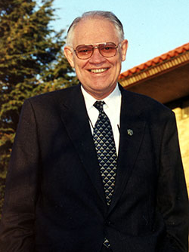
... the claim that perfect health is obtainable through faith runs counter to the Scripture's witness of man's mortality. Then, it completely overlooks a well-attested purpose of sickness.
Dr. Henry Krabbendam
Notes:
Consider these words of Henry Krabbendam:
... the claim that perfect health is obtainable through faith runs counter to the Scripture's witness of man's mortality. Then, it completely overlooks a well-attested purpose of sickness

Slide 22
Just as in the case of judgments (I Cor. 11:30), chastisements (Hebrews 12:5-11), and trials (James 1:2-3), there are times when sickness is designed to elicit repentance, to produce endurance, and to result in holiness.
Dr. Henry Krabbendam
Notes:
Just as in the case of judgments (I Cor. 11:30), chastisements (Hebrews 12:5-11), and trials (James 1:2-3), there are times when sickness is designed to elicit repentance, to produce endurance, and to result in holiness.
Earl Paulk's theology asserts the Sovereignty of Man. This is a heretical departure from the teaching of the Bible which asserts the Sovereignty of God. Sometimes, the Sovereign of the Universe wills that we suffer.

Slide 23
Revelation 2
¹⁰ Do not fear what you are about to suffer…
Notes:
Revelation 2
¹⁰ Do not fear what you are about to suffer. Behold, the devil is about to throw some of you into prison, that you may be tested, and for ten days you will have tribulation. Be faithful unto death, and I will give you the crown of life.

Slide 24
Matthew 10:28
And do not fear those who kill the body but cannot kill the soul. Rather fear him who can destroy both soul and body in hell.
Notes:
Matthew 10:28
And do not fear those who kill the body but cannot kill the soul. Rather fear him who can destroy both soul and body in hell.

Slide 25
Revelation 2
¹⁰ Do not fear what you are about to suffer. Behold, the devil is about to throw some of you into prison, that you may be tested, and for ten days you will have tribulation. Be faithful unto death, and I will give you the crown of life.
Notes:
Revelation 2:10
¹⁰ Do not fear what you are about to suffer. Behold, the devil is about to throw some of you into prison, that you may be tested, and for ten days you will have tribulation. Be faithful unto death, and I will give you the crown of life.
a. They are assured that they will suffer at the hand of Satan.
b. The immediate consequences of that suffering would be severe.
10 days: Difficult to interpret the exact meaning of this number.
-- could be a means of emphasizing that the persecution would be acute, but limited in duration.
-- More likely, it is intended as a large number indicating the extent of the persecution. This was to be an imprisonment culminating in execution.

Slide 26
Ruling Crown
“Diadema”
Victor’s Crown
“Stephanos”
Notes:
However, the Smyrnan Christians are reminded of the eternal reward which would ultimately be theirs -- the crown of life.
1. Not the royal crown: diadema.
2. Smyrna had a large athletic stadium and was famous for its athletic games. The crown mentioned is the "stephanos," the victor's crown.
3. They are not promised that they will avoid physical harm. However, they are promised a more significant deliverance; deliverance from the Second Death. A double negative in the Greek doubly assures them that they absolutely will not suffer the second death, a rabbinic term used to refer to the death of the wicked in the next world.
2. He reminds them of the spiritual reward which awaits those faithful, even unto death.

Slide 27
Revelation 2
¹¹ He who has an ear, let him hear what the Spirit says to the churches. The one who conquers will not be hurt by the second death.’
Notes:
Revelation 2:11
¹¹ He who has an ear, let him hear what the Spirit says to the churches. The one who conquers will not be hurt by the second death.’

Slide 28
“No pain, no palm; no thorns, no throne;
no gall, no glory;
no cross, no crown.”
William Penn
Notes:
There are many perspectives on suffering. The Christian perspective is shaped by a knowledge of the necessity of Christ's suffering. William Penn, the founder of Pennsylvania stated it well:
"No pain, no palm; no thorns, no throne; no gall, not glory; no cross, no crown."

